Slide 1
Resource launch
Region
Presenters
Date
Language

Slide 2
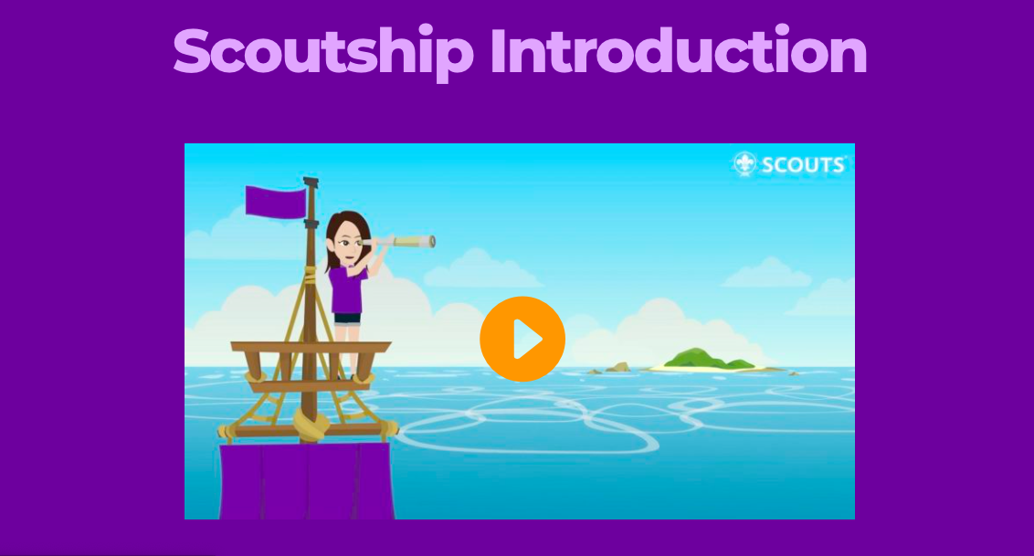

Slide 3
World Scouting’s new comprehensive online resource.
The Scoutship will support NSOs/NSAs in navigating the important area of adult management to ultimately ensure successful delivery of a relevant programme to young people.

Slide 4
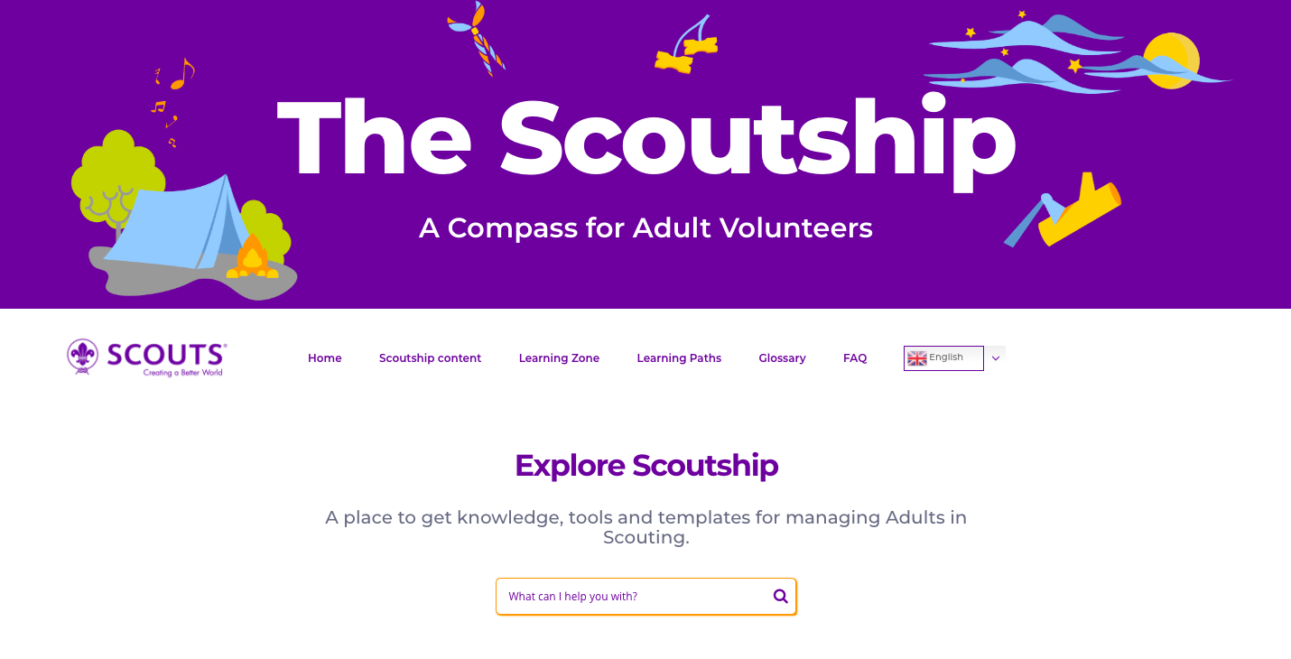
Supports better management of Adults in Scouting,
Supports Youth Programme implementation,
Builds quality leadership,
Supports organisational structures, and
Creates positive adult volunteers' experience.

Slide 5
The content and the style of Scoutship are addressing equally NSO/NSA leadership and Adults in Scouting. We also encourage Rovers to join the exploration for their growth in the movement. And last but not least, we are aiming to provide support to external audiences.

Slide 6
As a Scoutship user you can:
surf over the content,
snorkel in and out or
really dive in deep to the content.
A short quiz is available to determine what type of Scoutship user you are.

Slide 7
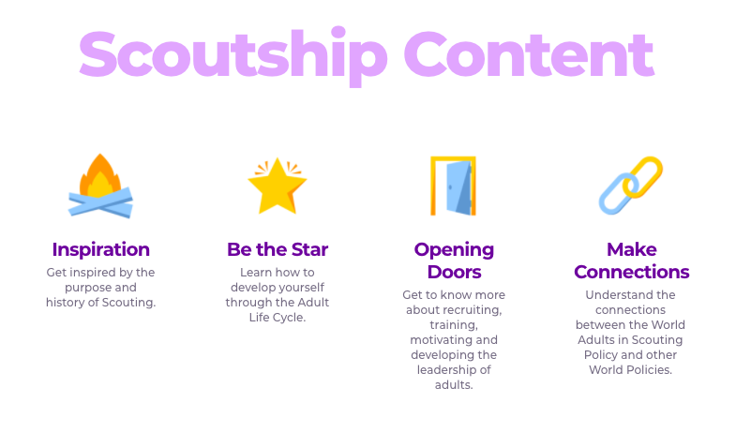
Inspiration - explore the purpose of Scouting and our historical background;
Be the Star - learn how to develop ourselves through volunteering and the Adults in Scouting Life Cycle;
Opening Doors - learn all about recruitment, leadership in Scouting and staying motivated;

Slide 8
Making Connections - understand the links between Adults in Scouting and the other policies of our Movement;
Going Forward - learn how to progress in your Scouting job/role/appointments for your personal growth;

Slide 9
Hammer and Nails - a toolbox with the tools you need for an adult development, Training 101 – find good practices, training and tips to boost our Scouting leadership and involvement.

Slide 10
Scoutship features:
Scoutship search engine
Quick navigation through content
Learning Zone
Learning Path
Different “On the Go” formats
Machine language translation
Glossary and FAQ section

Slide 11
Most of the content is organised as “One-pagers”, making it easier and quicker to read. This enables instant use and getting the answer on a question in a very short time. Scoutship can be a short view or reading while traveling, waiting or just having short moment of free time.

Slide 12
Learning Zone is a menu item with content that assists users in understanding and supporting volunteers more through a number of accessible WOSM Policy and support documents relative to key strategic and operational priorities.

Slide 13
A Learning Path - a pathway to navigate through the content if you are doing a specific task or are looking for content for a specific purpose. A path to follow specific learning needs of the NSO/NSA and individuals.

Slide 14
Scoutship on the go is available in:
Regular pdf format
ePUB format for Smartphones
Mobi format for tablets, IPads and Kindle

Slide 15
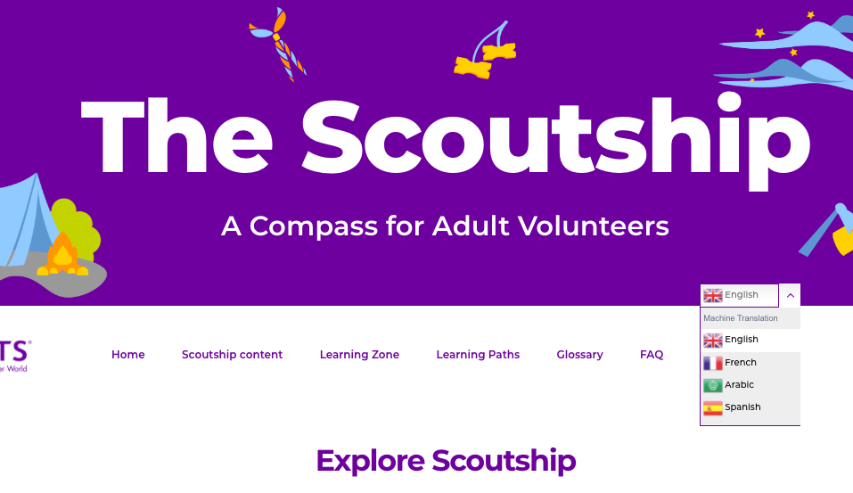
Machine translation of the content to French, Spanish, Arabic and Russian.
Subtitled introduction video and translated style quiz.

Slide 16
A glossary for users outside Scouting offers over 50 key words to help them better understand how we are managing our adults/volunteers in Scouting.

Slide 17
Frequently Asked Questions section offers 25 most frequent questions of the regular users. Additional questions can be sent over the platform user email.

Slide 18
Questions, answers, comments, ideas
I want to clarify or better understand …
I have a need …
I want to comment …
I have an idea for the future …
…

Slide 19
Value Statement
What would you tell about the Scoutship
to the next person you meet?
How would you share this information within your NSO/NSA?

Slide 20
Thank you
http://scoutship.scout.org/home
https://services.scout.org/service/3
scoutship@scout.org

